Slide 1

BOSS LOTF Chair
Amy Remmer

Slide 2

Why would I like to Apply?
I would like to Apply for the position of Chair on the LOTF committee as i would love to inspire of a movement within the industry which I feel is such a vital part in making sure the industry continues to thrive and grow by energizing and inspiring a generation of future leaders through our webinars and conferences. As the OP sector continually grows and evolves so should the workforce and this is something I would love to cover over the 2 years as Chair. Taking a closer look at inspiring future leaders through individuality. I personally feel privileged to have been on the committee for over a year now and I truly feel that the work we undertake collectively has a huge impact on the next generation of aspiring leaders and is vital not only in the continuation of the Office supplies industry but also in the growth and transformation of it.
R

Slide 3
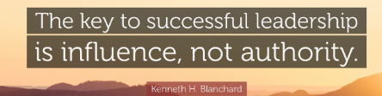
The next 2 years? Influencing leadership
Within the next 2 years I would like to look closely at attributes and skills that are needed to become a Leader. I would like to empower the younger generation of our industry with the tools and mindset needed to grow and develop within our community. Understanding the vision of leadership, what is Leadership, what does it look like in practice-? how do i get there – Practical steps to take? As the world around us changes especially within the younger generation with social media and the wave of ‘influencers’ I found the quote below quite interesting and striking
This is something everyone could take something away from. My Theme for the next 2 years would be Influencing leadership and over the 2 years I would like to delve into the difference of being a ‘boss/manager’ and being a leader. The key factor is ‘influence’ Having the ability to influence others on your vision/direction and bring them on your journey. Over the last 2 years we have set a roadmap of being the best version of yourself and as continuation of this I would like the next 2 years to be a training and skills focused as possible to cover off more detail of Leadership styles and understanding that not one size fits all. As a leader, understanding your leadership style is important as once you understand your leadership style this can determine how this affects those you directly influence. It will also help define your leadership strengths and which leadership skills you need to develop which will also go hand in hand with the Mentor/Mentee program and allow any participants to fully utilise the time with the mentor as they will have identified areas that they need to work on.
R

Slide 4
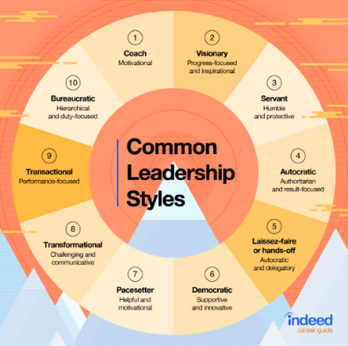
The next 2 years continued…
I would really like the goal to be over the next 2 years that delegates can come away with some practical skills/achievements that LOTF have provided them with to utilise in their career growth. I would really like to get more dealer inclusion on these events, and I feel that my network that I have built over my career will help us achieve this. I would like to set myself a goal of having over 15 dealers regularly sending attendees to our events. With Scott sadly leaving the committee this leaves a gap in terms of EVO connection and visibility. I feel that with my presence and connections within EVO I would like to think we could boost Evo attendees as EVO is one of the largest companies within the community and gain more revenue from attendees and sponsorship.
R

Slide 5
What value will I bring to the position?
I would really like to widen our community further and gain a wider audience to attend conferences and webinars and i would like to think I bring Value in my network within the dealer community, and I would like to use that to widen our audience and get more dealer participation in our events. Through my 12 years within the industry I have worked for wholesale, dealer and for a contract stationer and I feel this has given me a wider understanding of the industry as a whole and I can bring this to the role of Chair. I have a huge passion and enthusiasm for our industry, and I feel strongly about developing people and empowering them to be the best they can be.
I am happy to teamwork with a Co-chair, I feel I could work with anyone who is on the committee And grow my relationship with them. I really enjoy a collaborative approach and hearing others' ideas and visions. I strive to be in the industry for a long time and I feel by becoming Chair/ Co- chair this will really help cement my place in the industry and help me strive for my long-term goals. I like to think I am a friendly and outgoing person who is confident, which I believe would help me share my vision with the community and I am always happy to speak publicly. I truly believe hard work and perseverance is one of my strong attributes, 5 years ago I would have never imagined I would be part of the LOTF and applying to be Chair/Co Chair, but I know that through my own career growth and attending the LOTF events and now being on the committee I feel so passionately about sharing this with others in the industry.
I have a huge drive and ambition to be as relatable and down to earth as possible all while continuing my own career growth and development. When I first started in this industry, I looked at leaders and thought that it would never be me, but through doing the LOTF I have realised that we ourselves make our goals and we are the only ones who can achieve them. Change starts from the Bottom.
R

Slide 6
Reference – Amy Remmer
Position of Chair/Co-Chair of the LOTF Committee
The best way to describe Amy is simply a breath of fresh air!
Amy’s progression in the VOW business has been rapid and she has gained a fantastic reputation with her colleagues over the past couple of years, now thriving in her role as an Account Director.
After maternity leave, Amy came back to work in the Customer Service Department in VOW at which point it was recognized that Amy possessed talent that would allow her to take on bigger challenges within the business. Amy’s first role in my team was a new role created to specifically push the Xerox brand. Amy grabbed this opportunity to shine by the scruff of the neck and quickly created a reputation for herself in the business as a shining star enjoying great success in the role. When an Account Director position became available in my team, I had a few options. I had some experienced sales professionals that were interested in the role and the rising star that was Amy who had also applied for the role. Amy had shown me so much passion and enthusiasm and indeed talent in such a short period, my decision to give her the step up was a relatively easy one.
She has now positioned herself as one of the most well liked and respected sales professionals in the VOW business. She tackles every challenge head on and has an infectious passion to thrive, learn and succeed. She is articulate and sets her own bar very high, but also possesses a personality that is quite unique.
Amy will never shy away from any challenge and has shown that with her involvement with BOSS thus far and comes highly recommended to take on her next one.
Stephen.
R

